Slide 1

DexNest ERP
Complete School Management System
👨‍🎓 Students
📋 Admissions
💰 Fees
🎓 Exams & Results
📆 Timetable
📱 Mobile Apps
🔔 Notifications
🛡️ Permissions
Feature-by-Feature Demo Presentation
20+
17
40+
2
Admin Modules
App Feature Flags
API Endpoints
Mobile Apps
Developed by Dexterosoft | dexnest.dexterosoft.com | info@dexterosoft.com
Notes:
Title slide. DexNest ERP is a complete school management system with web admin panel + 2 Android apps. Pilot school: STSVM, Sitapur, UP. Built by Dexterosoft.

Slide 2


SYSTEM OVERVIEW
One System. Three Components.
Web Admin Panel
Student Android App
Teacher Android App
Browser-based — works on any device, any browser
10 features for students — all toggleable by admin
6 features for teachers — all toggleable by admin
20+ management modules in one place
Login: Roll Number + OTP (sent to phone)
Login: Employee Code + OTP (sent to phone)
Roles & permissions — operators see only what you allow
View fees, homework, timetable, syllabus, results
Mark class attendance from anywhere
PDF generation for TC, Marksheet, ID Cards, Migration Cert
Apply for leave from phone — admin approves in panel
Assign homework with file attachment
Real-time app feature control — no app update needed
Pull-to-refresh for instant data and settings update
View timetable and download salary slips
All three components share one database via REST API — real-time sync, no duplication
Notes:
Three-component architecture. Admin panel manages everything. Both apps consume the same API. Login uses OTP — student gets OTP on their registered phone number, teacher gets OTP on staff mobile.

Slide 3


ADMIN MODULE 1 OF 12
Student Management
Online App Self-Registration
Student Journey
Student fills form in app → class preference → admin sees in Pending Approval list
One-Click Approval
1
Registers via app
Admin clicks Approve → Admission No + Roll No auto-generated → class allocated instantly
Fills form + selects class preference
Complete Student Profile
2
Pending Approval
Name, DOB, Aadhaar, blood group, photo, parent details, emergency contact — all stored
Appears in admin Pending list with yellow badge
Document Upload
3
Admin Approves
One click — Approve button
Student uploads Aadhaar, TC, photos from app — admin can view and download anytime
4
Auto-Generated
Year-wise Class Allocation
Admission No + Roll No created
Each academic year student is placed in a class-section. All previous years preserved
5
Class Allocated
Year-end Promotion
Placed in class-section for current year
Promote entire class to next class in one click. Roll numbers auto-reassigned for new year
6
Logs into App
TC Issuance & Deactivation
Full access to all enabled features
Issue TC → student record locked → cannot login to app → new school can verify TC number
Notes:
Roll numbers auto-reset per class per year. TC issuance automatically locks the student out of the app — no manual step needed. The whole onboarding flow from registration to first login takes under 2 minutes.

Slide 4



ADMIN MODULE 2 OF 12
Admissions & Enquiry Management
Enquiry Pipeline — track every parent from first call to final admission
NEW
CONTACTED
VISITED
CONVERTED
DROPPED
Parent calls / walk-in
Enquiry recorded
→
Admin calls parent
Details collected
→
Parent visits school
Application filled
→
TC verified & approved
Student admitted
→
Not interested
Enquiry closed
Walk-in Application
TC Verification Gate
Waiting List
Enquiry → Student
Student personal & parent details
Students from other schools need TC
Class full? Add to waiting list
One click converts VISITED → Application
Class applied for + academic year
Admin enters previous school TC number
Position numbers: #1, #2, #3...
Pre-fills all details automatically
Document checklist — tick what received
Must click "Mark TC Verified" first
Approve when seat opens
Saves re-entry of parent information
Admission No auto-generated on approval
System blocks approval until TC verified
Tracked per class per academic year
Full history from first call to admission
Notes:
Admissions handles walk-in parents who come directly without using the app. TC verification gate is legally important — student from another school cannot be admitted without verifying their Transfer Certificate.

Slide 5



ADMIN MODULE 3 OF 12
Attendance Management
Student Attendance (Admin)
Staff Attendance
Teacher App Attendance
Attendance Reports
Mark daily attendance by class-section
Mark daily attendance for all staff
Teacher selects class from app
Class-wise percentage report
Status: Present / Absent / Leave / Holiday
Present / Absent / Leave / WFH
Loads all students in one tap
Date-range filter — daily to full year
"Mark All Present" button for quick entry
Absent teacher → timetable red badge alert
Tap P / A / L per student
Green >90%, Orange 75-90%, Red <75%
Holiday auto-marks from school calendar
Staff leave applied via teacher app
"All Present" bulk button
Student-wise monthly record
Date-range reports with percentage
Monthly staff attendance report
Live count: P:28 A:2 L:0 shown as you mark
Defaulter list by threshold
Submit → syncs to admin instantly
Export to PDF for records
Notes:
Staff attendance feeds directly into timetable substitution — when a teacher is marked absent, the substitution page shows a red badge immediately. Teacher can also mark attendance from app anywhere without coming to school.

Slide 6
ADMIN MODULE 4 OF 12
Fee Management
🏗️
1. Setup Fee Heads
📋
2. Create Fee Structure
Create categories once: Tuition, Transport, Library, Exam Fee
→
Assign amounts per class (e.g. Class 1: Tuition ₹500/month)
📄
3. Generate Invoice
💳
4. Collect Payment
Select student → amounts auto-fill from structure → set due date
→
Cash / UPI / Cheque → payment receipt auto-numbered → PAID status
📱
5. Student Sees in App
📊
6. Reports & Defaulters
Invoice and payment history visible in student app when enabled
→
Fee collection summary + defaulter list by class or date
⭐ Invoice & receipt numbers are auto-generated — no manual numbering ever. Push notification sent to student when invoice is generated.
Notes:
Generating an invoice does NOT mark it paid — admin must separately record the payment. This ensures accurate accounts. The fee collection report shows who has paid, who has partial payments, and who has pending dues.

Slide 7

ADMIN MODULE 5 OF 12
Exams & Results — Dual System
Method 1 — Bulk Exam System
Method 2 — Manual Marksheet
① Create Exam Term (Mid-term, Final, Unit Test)
→ Go to Report Cards section in admin panel
② Add Subject Papers — max marks + exam date per class
→ Select student (searchable dropdown)
③ Bulk Marks Entry — enter for all students at once
→ Enter exam name (e.g. Half-Yearly 2025-26)
④ Live validation — marks turn green (pass) or red (fail)
→ Add subjects one by one with max and pass marks
⑤ Auto grade calculated: A1 (91-100%) → E (below 33%)
→ Grade and percentage auto-calculate as you type
⑥ Publish → Report Cards created and visible in student app
→ Generate & Save — PDF ready to print immediately
✅ Both methods run simultaneously — admin controls which is active from Module Settings. Bulk exam results auto-appear in manual marksheet section after publishing.
Auto Grade Scale
A1
A2
B1
B2
C
D
E
91-100%
81-90%
71-80%
61-70%
51-60%
33-50%
<33%
Notes:
Dual exam system is a key differentiator. Schools already using manual marksheets can continue — bulk system can be added when ready. Both publish to the same report cards table the student app reads.

Slide 8

ADMIN MODULE 6 OF 12
Timetable & Substitution
Setup Timetable
Substitution — Smart System
Teacher Workload Report
Period-wise schedule per class (Mon–Sat)
Select date → all periods for all classes shown
Periods per teacher per day automatically counted
Assign teacher + subject per period slot
Absent teachers highlighted in orange automatically
Weekly total per teacher summed
Break and Lunch periods auto-excluded
Cross-checks with Staff Attendance marked that morning
Under 20 periods = Normal (green badge)
Students view timetable in app
Assign substitute teacher or mark as Free Period
20-29 periods = Heavy (orange badge)
Teachers view their own schedule in app
Sidebar shows red badge count when pending
30+ periods = Overloaded (red badge)
⚡ When a teacher is marked Absent in Staff Attendance → timetable automatically flags their periods with red badge. Admin never has to manually figure out which classes need coverage.
Notes:
The substitution system is the most appreciated admin feature. It automatically cross-references staff attendance with the timetable — one screen shows everything that needs to be covered.

Slide 9


ADMIN MODULES 7 & 8 OF 12
Homework, Syllabus & Notices
Homework Management
Syllabus Management
Notices & Announcements
Admin or teacher assigns homework
Month-wise syllabus per subject per class
Create notice with title and full body text
Select class, subject, due date
Admin enters topics month by month
Target: All / Students Only / Staff Only
Add description + attach file (PDF or image)
Students view full syllabus in app anytime
Set publish from and publish until dates
Push notification sent to ALL students in class instantly
Parents can track what is being taught each month
Latest 5 notices shown on student home screen
Students view with due date in app
No printout needed — digital, always updated
Push notification sent when notice is published
Teachers can assign directly from teacher app too
Can be updated anytime from admin panel
Integrates with school calendar events
🔔 All three modules trigger automatic push notifications to the app — no manual messaging needed. Works even when app is closed.
Notes:
Homework push notification is very popular with parents — instant alert when homework is assigned. Syllabus module means no printing or distribution needed — parents just open the app.

Slide 10


ADMIN MODULES 9, 10, 11 OF 12
Staff, Salary & Certificates
Staff Management
Salary Management
TC & Migration Certs
ID Cards
Full staff profile with photo
Salary structure: Basic + HRA + DA + TA
Transfer Certificate — 10 templates to choose
10 built-in template designs
Auto employee code generation
Deductions: PF, TDS, Professional Tax
Migration Certificate — 10 templates
Select class → filter students
Department and designation tracking
Monthly salary processing in one click
Auto TC and cert number generation
Photo or auto-initials avatar (e.g. AY)
Teaching vs non-teaching flag
Auto salary slip — printable PDF
TC deletion disabled — legal document
Bulk generate for entire class
Monthly attendance marking
Teacher views salary slip in app
TC issuance locks student out of app
Multiple cards per A4 sheet
Staff leave apply and approve flow
Annual salary summary report
Download as PDF — print ready
Download PDF — print and laminate
💡 ID Cards: students without a photo automatically get a colored initials avatar — no blank cards ever. Works in both browser preview and PDF.
Notes:
TC issuance is linked to student deactivation — automatic, cannot be bypassed. Initials avatar means even schools with no student photos can generate professional ID cards.

Slide 11


ADMIN MODULE 12 OF 12
Reports, Permissions & Settings
Available Reports
Student Attendance Report
Staff Attendance Report
Class-wise, date-range, percentage
Monthly staff presence summary
Fee Collection Report
Fee Defaulters List
By class, month, and fee head
Students with pending invoices
Student Strength Report
Student Register
Boys/girls count per class
Printable class-wise list
Teacher Workload Report
Salary Annual Report
Periods per teacher per week
Staff-wise yearly summary
Roles & Permissions
Module Settings
Admin = full access always
Operator = only modules you assign
Per-module: View / Edit / Delete / Manage
Sidebar auto-hides unauthorized sections
Current academic year control
Default document templates (TC, Migration, Marksheet)
Date format, currency symbol, OTP expiry time
Enable/disable any module or app feature
Notes:
All reports are printable as PDFs directly from browser — no Excel needed. Permissions allow giving accountant access to only Fees, receptionist only to Students, etc.

Slide 12
MOBILE APP — STUDENT
Student Android App — All 10 Features
Login: Roll Number → OTP sent to registered mobile number | Works without password
🏠
📅
💰
✏️
📅
Home Dashboard
Attendance
Fee Invoices
Homework
Timetable
Profile: name, class, roll no, photo
"Quick action" buttons for all features
Document count + school notices (latest 5)
Pull-to-refresh updates all data + flags
Month-wise P/A/L records
Monthly attendance percentage
Color-coded monthly view
Full academic year summary
All pending and paid invoices
Amount, due date, PAID/PARTIAL/PENDING
Payment history with receipt No.
Admin toggles visibility in Module Settings
Subject-wise homework with due date
Full description + attached file
Push notification when assigned
Admin toggles visibility
Weekly class timetable
Subject, teacher, time per period
Today highlighted automatically
Admin toggles visibility
📖
📋
🎓
📁
👤
Syllabus
Leave Application
Report Cards
Documents
Profile
Subject-wise monthly topics
See what is being taught
Parents track learning progress
Admin toggles visibility
Apply for leave from phone
Select type, dates, reason
Track PENDING/APPROVED/REJECTED
Admin toggles visibility
View published exam results
Subject marks, grades, percentage
Only shows after admin publishes
Admin toggles visibility
Upload personal documents
Aadhaar, TC, photos, certificates
Admin can download anytime
Admin toggles visibility
View all personal details
Update photo from camera or gallery
Class, section, roll number
Always visible — no flag
Notes:
Each feature can be turned ON or OFF by admin from Module Settings — button disappears from home screen without any app update. OTP login means no passwords to remember or lose.

Slide 13
MOBILE APP — TEACHER
Teacher Android App — All 6 Features
Login: Employee Code → OTP sent to registered staff mobile number | No password needed
Home Dashboard
Mark Class Attendance
Assign Homework
Staff name, designation, department
Select class-section from dropdown
Select class and subject
Notice count badge on home
Load all students with one tap
Enter title, description, due date
Quick action buttons for all 5 features
Tap P / A / L per student individually
Attach a file (PDF or image)
Cached name shown before API response loads
"All Present" and "All Absent" bulk buttons
Save → push notification to ALL class students
Pull-to-refresh updates data and flags instantly
Live count shown: P:28 A:2 L:0 as you mark
Homework visible in student app instantly
Feature buttons show/hide per admin settings
Submit → syncs to admin panel immediately
Assign from anywhere without coming to school
View Timetable
View Salary Slips
Leave Application
Personal timetable for that teacher only
Month-wise salary slips
Apply for leave from mobile app
Class, subject, period, time slot
Basic + HRA + DA + TA breakdown
Types: SICK / PERSONAL / FAMILY / CASUAL
Day-wise view Monday to Saturday
Deductions: PF and TDS shown
Select dates and enter reason
Today's schedule auto-highlighted
Net pay prominently displayed
Track PENDING / APPROVED / REJECTED status
Helps teacher prepare lessons in advance
Can download for personal records
Admin approves or rejects from web panel
Admin toggles visibility in Module Settings
Admin toggles visibility in Module Settings
Admin toggles visibility in Module Settings
Notes:
Teacher app: attendance marking syncs directly to admin panel. Homework assignment means teachers don't need to physically come to school to assign homework. OTP login — no password management needed.

Slide 14

UNIQUE FEATURE — REAL TIME CONTROL
Admin Controls App Features Instantly
Turn any student or teacher feature ON or OFF — no app update, no server restart, takes 2 seconds
⚙️
💾
📡
🔄
✅
→
→
→
→
Admin changes
setting in panel
Saved to database
instantly
App calls API on
next open
Pull-to-refresh
triggers it now
Button appears
or disappears
Student App — 12 flags
Teacher App — 6 flags
Admin Modules
Fees
Exam Results
Salary Slip
Exam & Results
ON
ON
ON
ON
Homework
Gallery
ON
ON
Leave Application
ON
Manual Marksheet
ON
Syllabus
Notices
ON
ON
Attendance View
Bulk Marks Entry
ON
ON
Timetable
Documents
ON
ON
Homework Assignment
ON
Login Block use cases:
Attendance
Self Registration
ON
ON
• Year-end transition
• System maintenance
• Exam period control
• Emergency lockdown
Leave
Timetable View
ON
ON
⛔ Block ALL Student Logins
⛔ Block ALL Staff Logins
Notes:
No other school ERP at this price lets admin control individual app features in real time. Login block is extremely powerful — instant access control without any app update or server restart.

Slide 15

COMMUNICATION SYSTEM
Push Notifications — Firebase FCM
Instant alerts to student and teacher phones — works even when the app is closed
Automatic — no admin action needed
📄
Fee Invoice Created
✏️
Homework Assigned
Sent to student when admin generates a new invoice
Sent to all students in that class immediately
📢
Notice Published
✅
Student Approved
Sent to targeted audience — All / Students / Staff
Sent to student when admin approves their registration
📊
Report Card Published
🔄
Leave Status Changed
Sent when exam results are published to app
Sent when admin approves or rejects leave application
Manual — send anytime
🔔 Send to All Students
🔔 Send to All Teachers
Broadcast to every student — announcements, events, urgent info
Broadcast to every teacher — meetings, schedule changes
🔔 Send to Specific Student
🔔 Send to Specific Teacher
Individual notification — fee reminder, discipline notice
Individual notification — schedule change, admin message
🔧 Powered by Google Firebase Cloud Messaging (FCM) — free, reliable, instant delivery. Replaces WhatsApp groups and SMS for school communication.
Notes:
Firebase FCM is free for the volume schools need. Push notifications replace WhatsApp group messages and SMS — everything is in the app and tracked. Works even when phone is on silent.

Slide 16
SECURITY & ACCESS CONTROL
Roles, Permissions & Security
👑 Admin
🧑‍💼 Operator
Full access to all modules always — cannot be restricted
Manages all operator users and their permissions
Changes school settings and module feature flags
Sees all sections in sidebar regardless of settings
Only sees what admin explicitly gives permission for
Per-module: View / Edit / Create / Delete / Manage
Sidebar auto-hides all unauthorized sections
Example: Accountant sees Fees only, Receptionist sees Students only
Permission matrix — per module, per operator
Module
View
Edit
Create
Delete
Manage
Students
✓
✓
✓
✓
✓
Fees
✓
✓
✓
✗
✓
Attendance
✓
✓
✗
✗
✗
Reports
✓
✗
✗
✗
✗
Exams
✓
✓
✓
✗
✓
🔐 Student login: Roll Number → OTP on phone | Teacher login: Employee Code → OTP on phone | No passwords needed
Notes:
OTP login means no password management, no forgotten passwords, no password resets. Student just needs their roll number — it's printed on their ID card. Teacher needs their employee code.

Slide 17
WHY CHOOSE DEXNEST
Why Schools Choose DexNest ERP
🇮🇳
Made for Indian Schools
⚡
Works on Shared Hosting
₹ currency, Hindi support, Aadhaar field, UP board structure, dd/mm/yyyy date format throughout
No expensive cloud server needed. Runs on ₹500/month shared hosting. We handle full installation.
📱
Free Android App Included
🔄
Real-Time Feature Control
Both student and teacher apps included at no extra cost. School branding on the APK.
Admin turns any app feature ON/OFF — takes effect in seconds. No app update, no server restart needed.
🔢
Smart Auto Numbering
🛠️
We Handle Everything
Roll numbers reset per class per year. Invoice, receipt, TC, admission — all auto-numbered. Zero duplicates.
We set up the server, database, app, and train staff. You just start using it from day 1.
💬
Local Support Available
🎓
Dual Exam System
Based in Sitapur, UP. Hindi + English. Phone and WhatsApp support. We understand your workflow.
Manual + bulk exam entry both available together. School decides which method to use per exam.
Notes:
Key value propositions for Indian schools: local support, cheap hosting, free app, we handle setup. Most schools don't have a dedicated IT person — we eliminate that need.

Slide 18
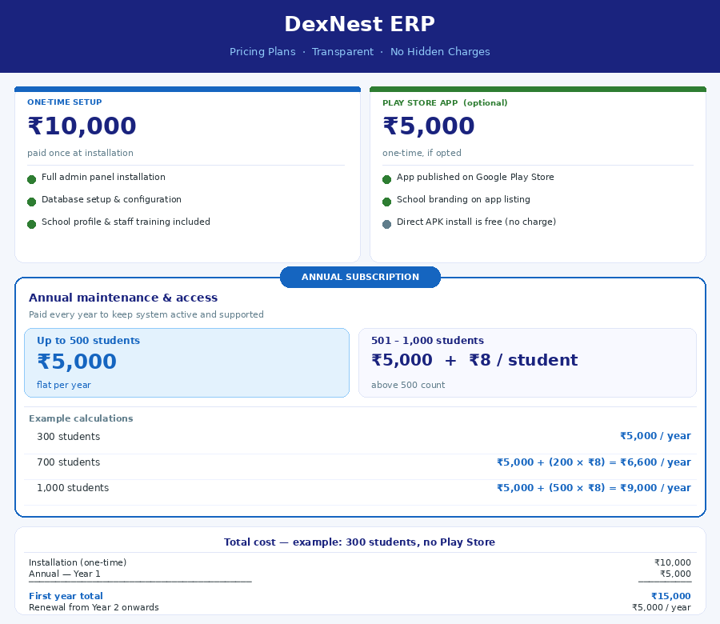
PRICING PLANS
Simple, Transparent Pricing
One-time setup + annual subscription. No hidden charges. No per-module fees.
Notes:
Pricing slide. Show the actual pricing image. Installation is a one-time charge of ₹10,000. Annual fee is ₹5,000/year for up to 500 students, then ₹8 per student above 500. Play Store publishing is ₹5,000 one-time optional. First year for 300 students: ₹15,000 total.

Slide 19
Ready to See DexNest ERP in Action?
Live demo available — see every feature working with real school data
🌐 Live Demo Website
🖥️ Demo Admin Panel
dexnest.dexterosoft.com
dexnest.dexterosoft.com/admin
✉️ Email:
info@dexterosoft.com
🌐 Website:
dexterosoft.com
📍 Location:
Sitapur, Uttar Pradesh, India
🏫 Pilot School:
STSVM, Sitapur, UP
Start with a FREE 30-day demo — no credit card, no commitment
अपने स्कूल का Demo मुफ़्त में देखें — आज ही संपर्क करें
Notes:
Final slide — leave on screen during Q&A. Demo website and admin panel are live. The Hindi tagline resonates well with school principals. Offer a free 30-day demo to close the meeting.

